Slide 1
Applying Generative AI methods to make possible Predictive Maintenance and Estimate Remaining Useful Life (RUL)
A Data-Driven Approach to Fault Detection
Notes:
Good [morning/afternoon], I’m Anish Sura. Today I’ll be presenting our predictive maintenance framework for centrifugal pumps. This approach combines statistical analysis, deep learning (autoencoders), and machine learning classification to improve fault detection and early failure warnings — especially where historical fault data is limited.

Slide 2
Content
Introduction:
Traditional vs generative AI
Developing application of generative AI methods to make possible predictive maintenance and estimate remaining userful life (RUL).
Methodology:
Data Preprocessing (cleaning, scaling).
Exploratory Analysis (trends, correlations).
Statistical and ML-Based Anomaly Detection, Evaluation and Insights Generation
Tools Used: Python, Autoencoders, Statistical Tests
Results & Discussion:
Predictive Maintenance Model Outcomes; Significant anomalies detected in value_TEMP and value_ACC.
Extract actionable insights from pump sensor data, from Analyzed: 5 key sensor features over time.
Conclusion:
Recommendations: Integrate findings into predictive maintenance systems
References:
Generative adversarial networks for data augmentation in machine fault diagnosis, Siyu Shao, Pu Wang, and Rugjang Yan, April 2019: https://www.sciencedirect.com/science/article/abs/pii/S0166361518305657
Notes:
In critical infrastructure like oil production, equipment failure can be extremely costly—not just in terms of repair, but also due to downtime and safety hazards. Predictive maintenance helps mitigate this by forecasting potential issues before they escalate.
Traditional AI approaches face several limitations here, mainly because:
• They rely on historical failure data
• Failures in high-value assets are rare, so we lack enough data
• Real-time implementation is difficult due to data complexity and variability
Our approach integrates Generative AI to overcome these limitations by generating realistic failure data, enabling smarter, data-driven maintenance planning.

Slide 3
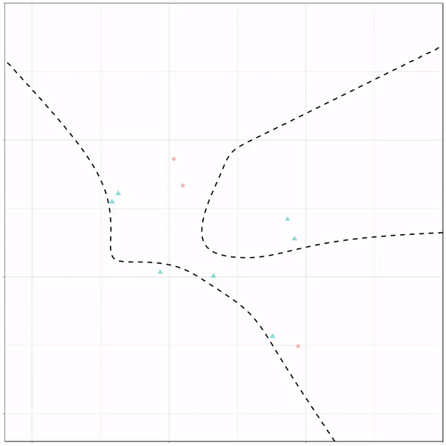
Traditional vs Generative AI
Example “Copilot”:
Generative artificial intelligence (AI) is a type of AI that generates images, text, videos, and other media in response to inputted prompts.
Images
Gemeni
Image Creator
Text
Videos
ChatGPT
Stable diffusion
Runway
Other Media
DALL-E
Anyword
Jasper
Traditional AI: Relies on explicit programming and predefined rules for specific tasks.
Based on historical patterns in data, predicts outcomes for specific use cases (e.g., numeric predictions)
Generative AI: Uses machine learning techniques to autonomously create new content based on learned patterns and data.
Understands context and generates novel human-like content (e.g., text, code, music, audio, video, data, etc.)
Notes:
Let’s break down the difference:
•Traditional AI is mostly rule-based or predictive using historical patterns. It works well when there’s plenty of labeled failure data, but that’s rarely the case in industrial setups.
•Generative AI, on the other hand, learns patterns and creates new, plausible data. It’s not just reactive—it’s creative. This opens the door for anomaly simulation, synthetic training data, and more robust predictive models.
Think of tools like GitHub Copilot or ChatGPT—they generate text or code from context. We use a similar idea to generate synthetic machine behavior data for training predictive models.

Slide 4
Limitations of Traditional AI Approaches
Generative AI for Predictive Maintenance
Advancement in AI for Predictive Maintenance
Recent AI advancements enable predictive maintenance across industries
Generative AI Algorithms
Capable of mimicking near-real time instances
Generate various operational anomaly instances
Combining AI Techniques
Solves challenges in predictive maintenance
Traditional AI Implementation
Can predict machine failure or abnormal behavior in advance
Depends on past historical failure patterns for self-learning
Scarcity of Historical Failure Scenarios
Makes model development harder
Challenges in implementing predictive maintenance solutions in real-time
Insufficient Data on Past Failures
Hinders development of accurate prediction models
Renders predictive maintenance solutions ineffective in real-time
Challenges in Developing Reliable Models
Difficulty in generalizing well to new situations
Notes:
There are several challenges with traditional predictive maintenance (PdM):
• It assumes you have past examples of failures, which isn’t always true.
• Models trained on rare events tend to be unreliable or overfit.
• And real-world systems have complex, nonlinear behaviors that static models can’t handle well.
This is why predictive maintenance often fails to deliver in real time—especially in upstream oil operations.

Slide 5
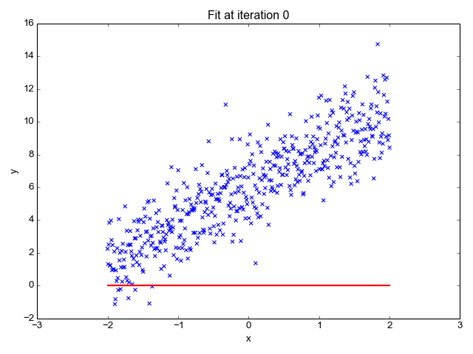
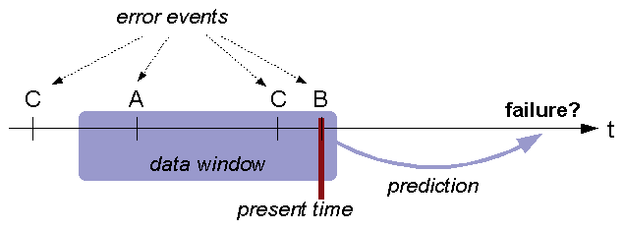
Challenges in Machine Failure Prediction
Factors in Machine Failure
Various factors can cause machine failures
Failure types and modes vary over time
Data Collection and Analysis Challenges
Difficulty in collecting and analyzing failure data
Current methods struggle to predict remaining useful life
Degradation Due to Failures
Equipment can degrade significantly from single or multiple failures
Identifying the right point of degradation is challenging
Animated Visualizations of Machine Learning Algorithms (davpinto.github.io)
Notes:
Failures are rarely caused by one simple issue. They usually result from complex interactions, like:
•Cavitation
•Pressure pulsations
•Seal or bearing wear
•Operator error
These failures often evolve over time, making it critical to monitor the degradation process and identify the ‘point of no return’—the moment preventive action must be taken. That’s exactly what our solution aims to do.

Slide 6
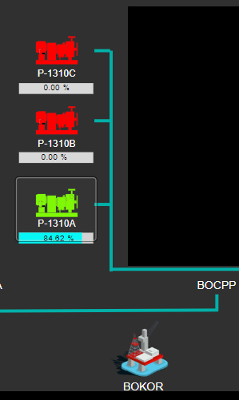
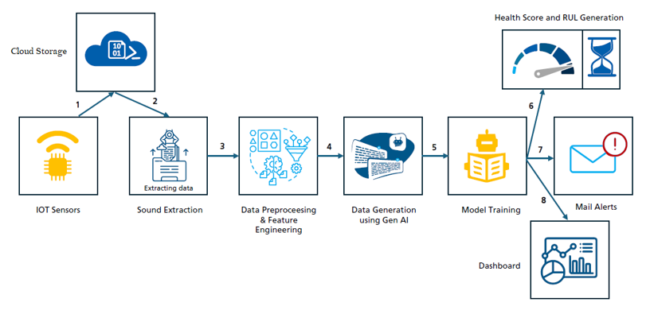
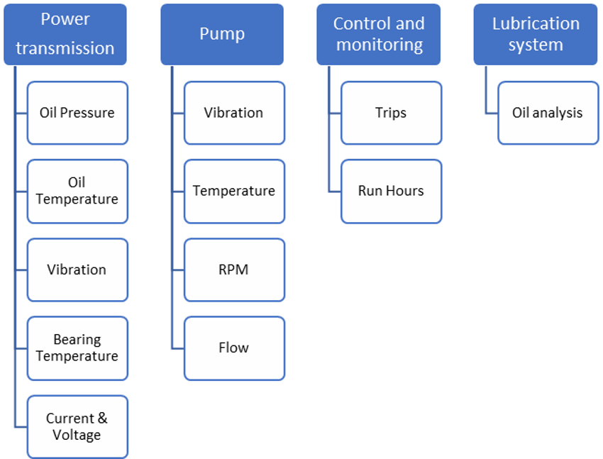
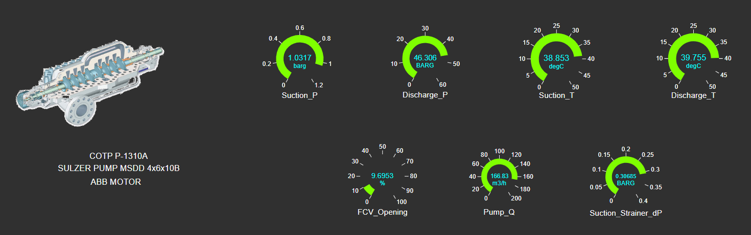
Application Implementation- Crude Oil Transfer Pumps
Scope
Data Applied
Equipment Failures
Implementation Scope
Predictive maintenance for Upstream equipment
Focus on Crude Oil Transfer Pumps
Covering critical failure modes
Generative AI Algorithm
Creates anomaly instances
Feeds data to predictive maintenance solution
Enhances model health
Remaining Useful Life (RUL)
Estimates RUL of the machine in advance
Data Collection from PI System
Gathering operational data
Analyzing collected data
Making predictions based on data
Focus on Critical Components
Identifying key components of Crude Oil Transfer Pumps
Prioritizing the most critical components
Most common cause of failure
Regular Wear and Tear
Cavitation
Pressure Pulsations
Excessive Radial or Axial Thrust
Suction and Discharge Recirculation
Mechanical Failures
Bearing Failure
Seal Failure
Gear Box Failures
Lubrication Failure
Excessive Vibrations
Improper Use or Operator Error
Human factor failures, including operator errors
Notes:
We focus on Centrifugal Pumps used in upstream crude oil transfer. These pumps are critical for operations, and common failure modes include:
Bearing Failure: Due to misalignment, poor lubrication, or fatigue. Seal Leakage: Caused by dry running, thermal distortion, or improper installation.
Shaft Seizure or Breakage: Often from overload, misalignment, or fatigue.
Vibration & Fatigue: Resulting from imbalance, resonance, or structural looseness.
---------------
Application Scope:
We focus on Centrifugal Pumps used in upstream crude oil transfer. These pumps are critical for operations, and common failure modes include:
•Mechanical failures like seal, bearing, or gearbox issues
•Process failures like recirculation or cavitation
•Human-induced errors
Our generative model:
•Simulates realistic failure patterns
•Trains predictive models
•Estimates RUL in advance, giving operators time to respond proactively

Slide 7
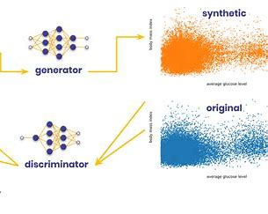
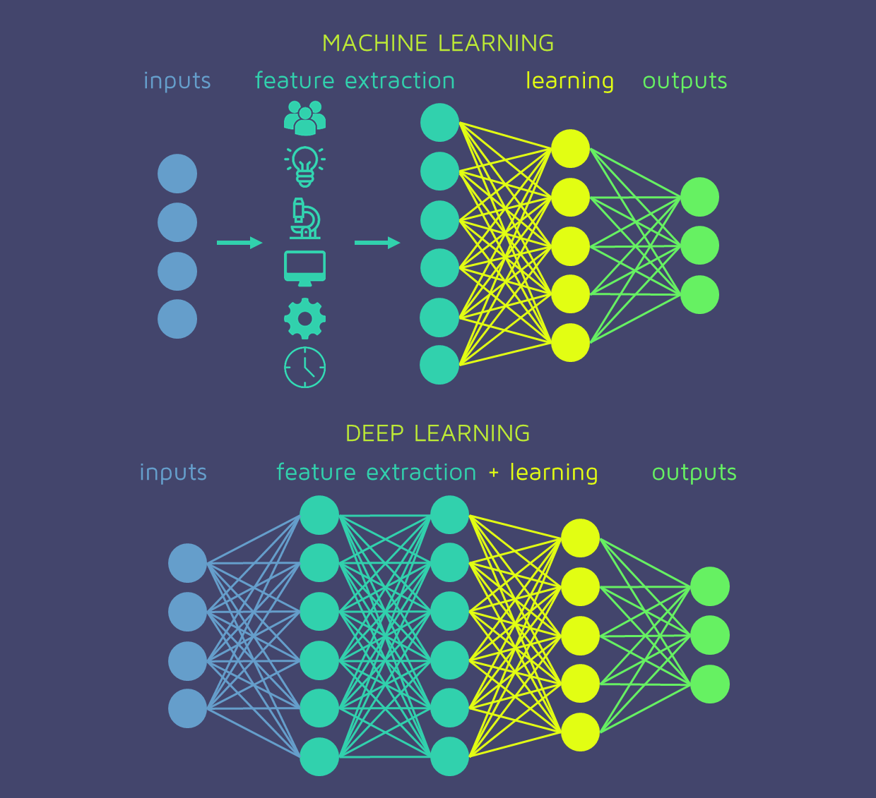
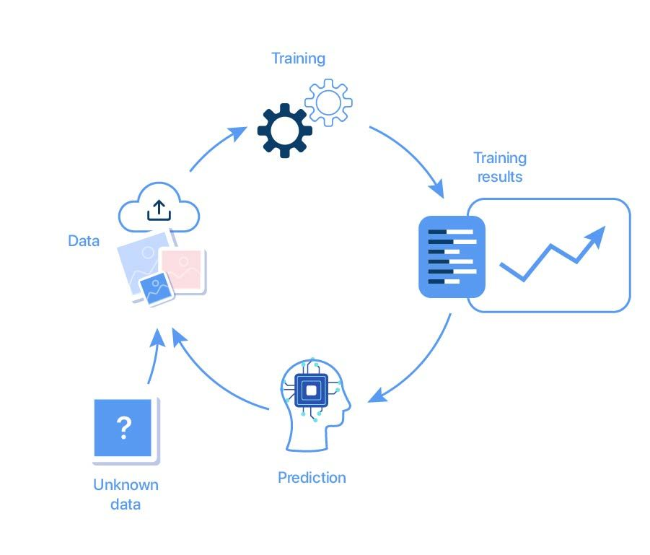
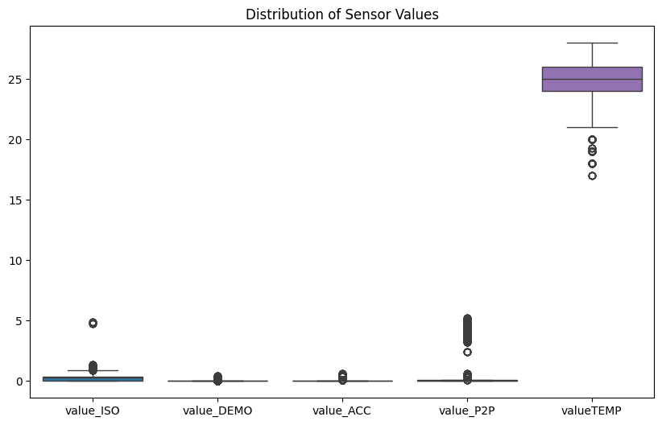
Data & Model
Feature Extraction
Model Training and Testing
Development and Testing Framework
Leverages generative adversarial networks (GANs)
Utilizes variational autoencoders (VAEs)
Modeling Complex Dynamics
Focus on upstream equipment
Handles nonlinear dynamics
Generating Realistic Synthetic Data
Used for training purposes
Used for testing purposes
Validation of Framework
Case study on upstream production system
Real-world data from offshore oil field
Model Finalization
Selecting a suitable model for the task
Data Utilization
Using prepared data for training the model
Performance Testing
Testing the trained model with unseen data
Evaluating model performance
Model Finalization or Iteration
If results are satisfactory, finalize the model
If not, return to feature engineering for improvements
Data Consumption by Analytics Team
Data is analyzed extensively
Exploratory data analysis is performed
Feature Engineering
Team uses domain understanding
Creates tailored features
Aims to provide better insights
Notes:
We focus on Centrifugal Pumps used in upstream crude oil transfer. These pumps are critical for operations, and common failure modes include:
•Mechanical failures like seal, bearing, or gearbox issues
•Process failures like recirculation or cavitation
•Human-induced errors
Our generative model:
•Simulates realistic failure patterns
•Trains predictive models
•Estimates RUL in advance, giving operators time to respond proactively

Slide 8
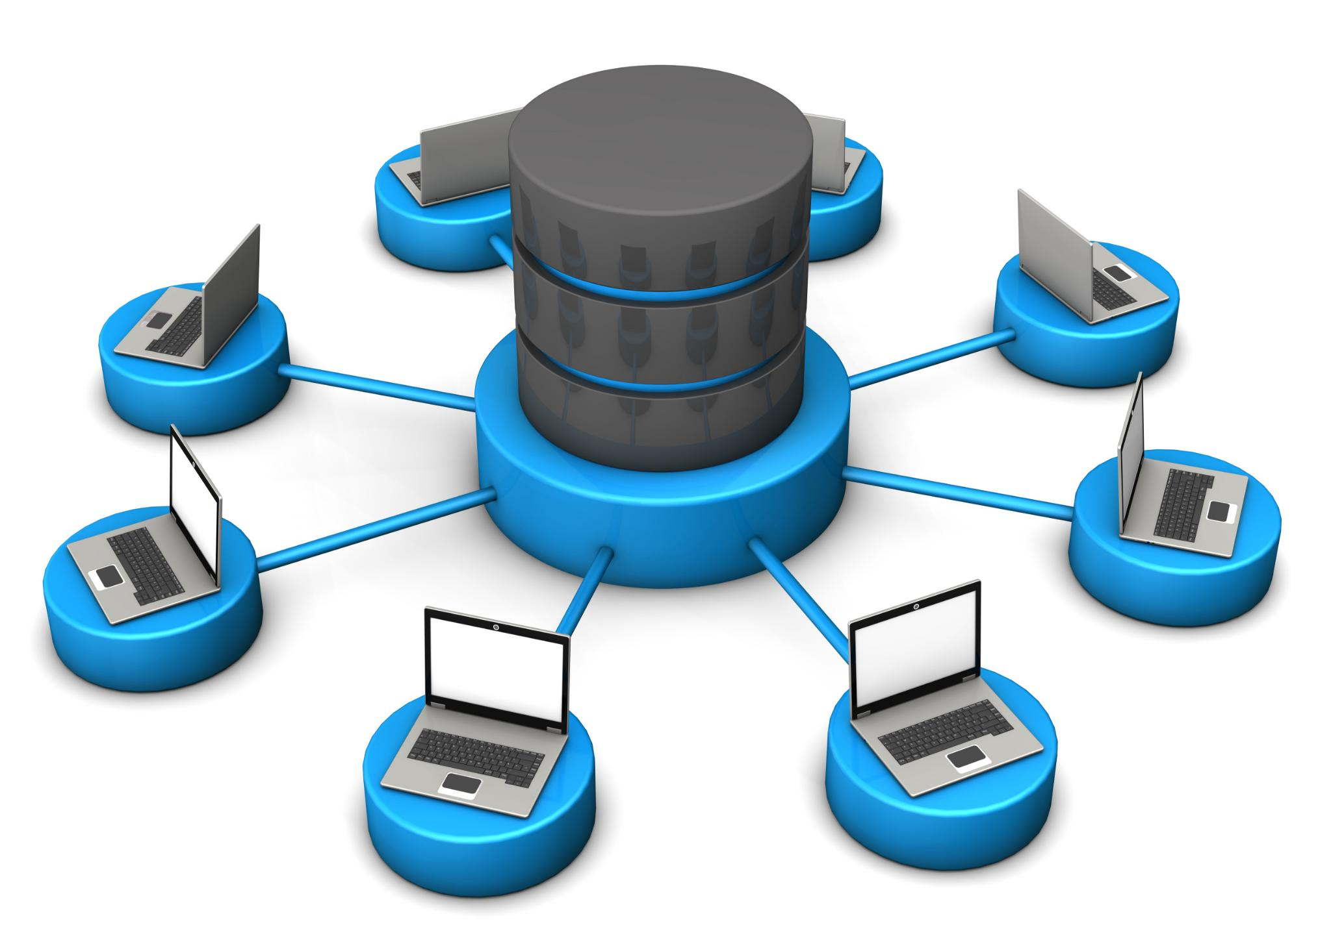
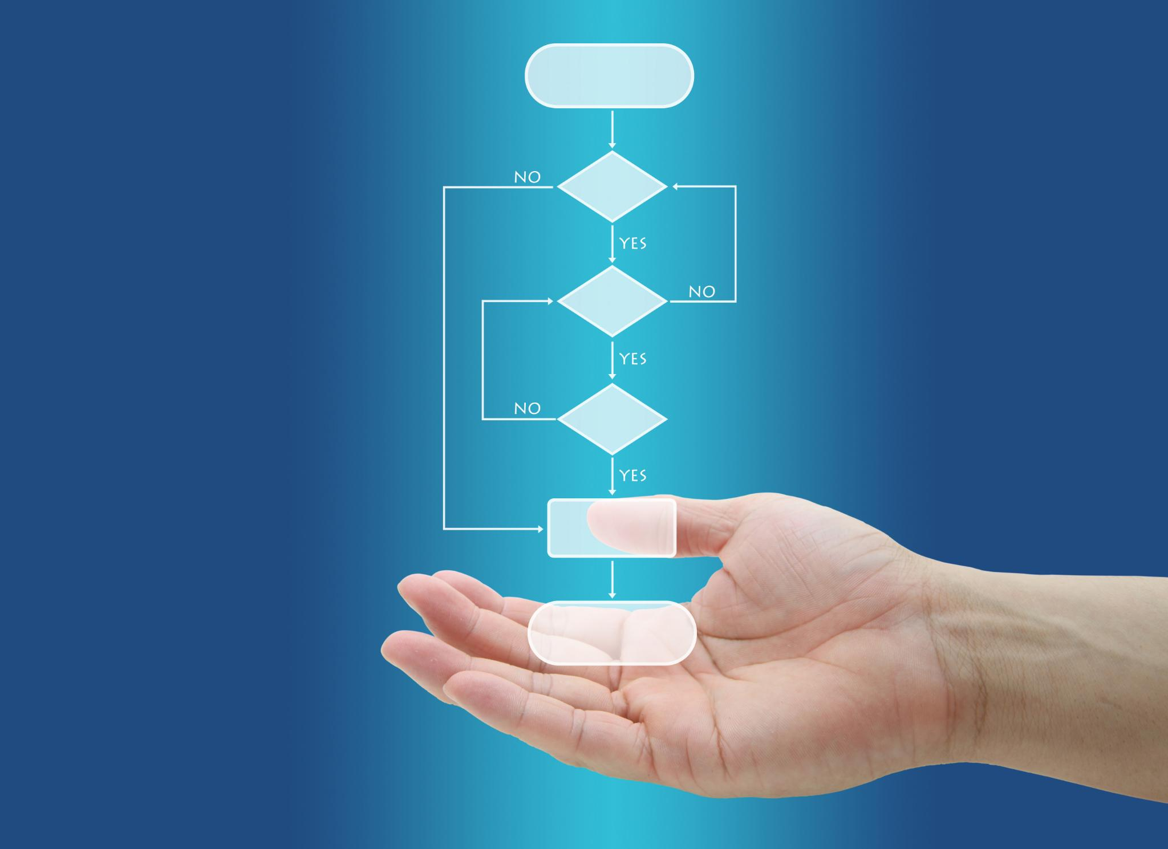

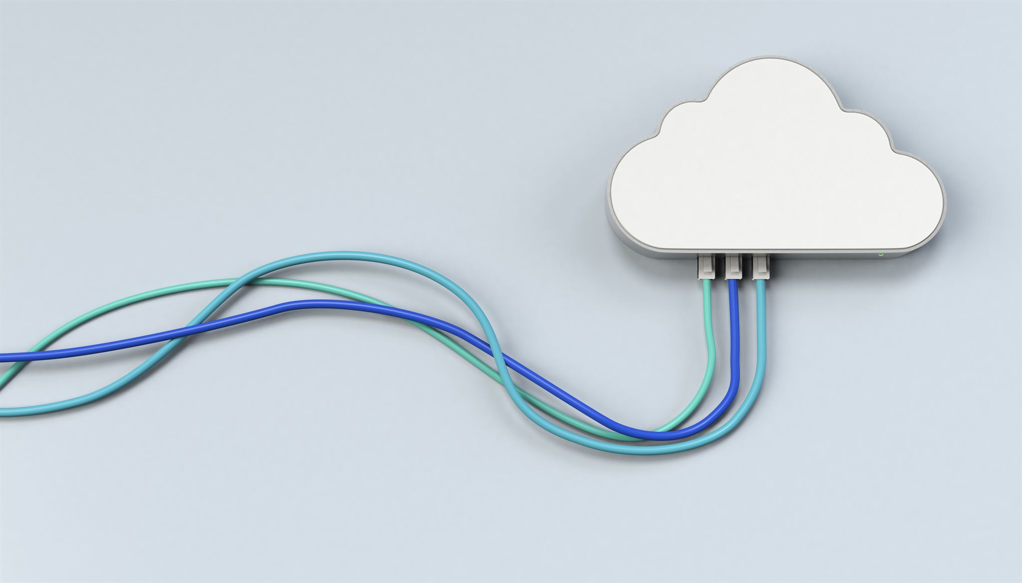
Stage 1: Data Acquisition
Stage 3: Data Processing and Model Inferencing
Data Acquisition Stage
Sensors deployed at the equipment
Collect real-time data
Store data in the local database (DB)
Data types collected
Pressure
Temperature
Oil flow
Vibration
Data Consumption in Azure Data Bricks
Data stored in Blob Storage is utilized
Used for pre-processing and model inferencing
Auto Encoder Model
Trained on historical data
Deployed for inferencing
Anomaly Detection
Model flags any anomalous points detected
Stage 4: Dashboard
Stage 2: Cloud-based IoT Hub
Cloud-Based Email Delivery
Used for sending email alerts
Alerts triggered by anomaly detection during inferencing
Anomaly Score Distribution
Shows the distribution of anomaly scores over time
Equipment Health Score
Indicates the overall health of the equipment
Contribution Plot
Displays the contribution of different factors
Historical Breakdown Data
Provides a historical view of the data
Cloud-based IoT Hub
Used for storing and processing data
Data Transformation and Storage
Data is transformed and stored in cloud storage
Stored at year, month, day, and hour granularity
Hourly JSON Files
Contains sensor values at second level
Notes:
Our implementation is broken into four stages:
Stage 1: Data Acquisition
•Sensors installed on equipment stream real-time data (vibration, temp, oil flow)
Stage 2: IoT Hub
•Data is stored in the cloud using blob storage and transformed into structured formats (JSON)
Stage 3: Model Inferencing
•Data is analyzed in Azure Data Bricks
•An autoencoder model flags anomalies by learning ‘normal’ behavior and identifying deviations
Stage 4: Dashboard and Alerts
•Real-time alerts are sent by email
•The dashboard shows:
•Anomaly scores
•Health indicators
•Historical trends

Slide 9
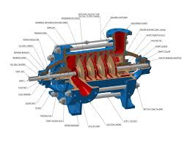
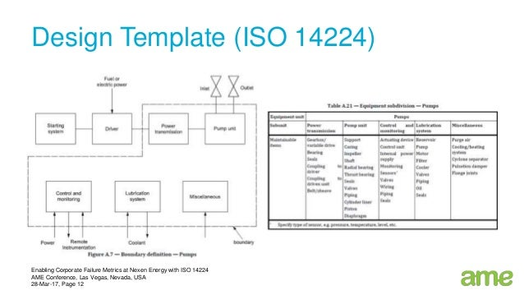
Centrifugal Pump

Slide 10
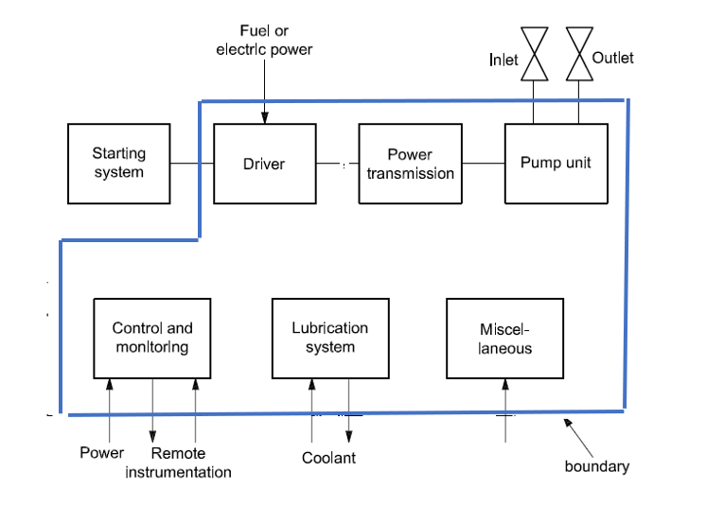
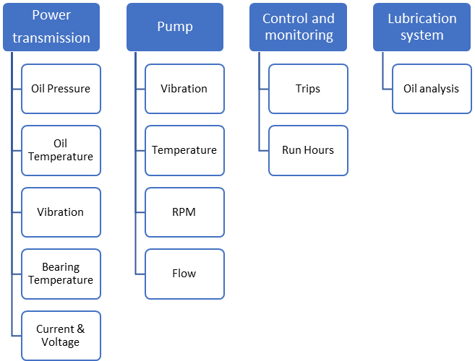
Crude Oil Transfer Pumps
Development and Testing Framework
Leverages generative adversarial networks (GANs)
Utilizes variational autoencoders (VAEs)
Modeling Complex Dynamics
Focus on upstream equipment
Handles nonlinear dynamics
Generating Realistic Synthetic Data
Used for training purposes
Used for testing purposes
Validation of Framework
Case study on upstream production system
Real-world data from offshore oil field
Data Collection from PI System
Gathering operational data
Analyzing collected data
Making predictions based on data
Focus on Critical Components
Identifying key components of Crude Oil Transfer Pumps
Prioritizing the most critical components
Notes:
This slide focuses on the development and testing of a framework using GANs and VAEs to model upstream equipment dynamics. It generates synthetic data for training and testing, validated through a case study using real-world data from an offshore oil field.
Original Content: Machine and equipment in focus: Also, applications will be used to develop and test framework that leverages generative adversarial networks (GANs) and variational autoencoders (VAEs) to model the complex and nonlinear dynamics of upstream equipment and generate realistic synthetic data for training and testing purposes. Also to validate the effectiveness of the proposed framework on a case study of an Upstream production system using real-world data from an offshore oil field.

Slide 11
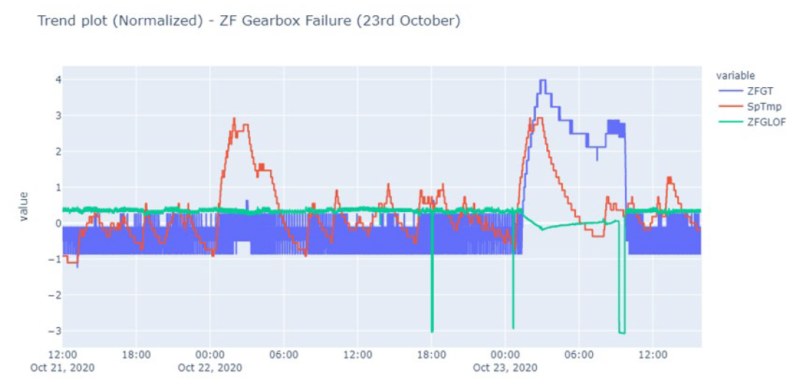
Example 1: Gearbox Temperature and Lubrication
Gearbox Temperature Increase
Observed 8 hours before failure
Significant rise noted
Reduced Lubrication Oil Flow
Observed alongside temperature increase
Contributes to failure indication
Trend Plot Analysis
Normalized values show correlation
Temperature rise and oil flow reduction linked to failure
Machine Status Information
Temperature increase during running state
Failure Date
Notes:
Example 1: Gearbox Failure
•A temperature increase, and lubrication drop were observed 8 hours before breakdown
•Trend analysis showed a clear correlation between rising heat and decreasing lubrication

Slide 12
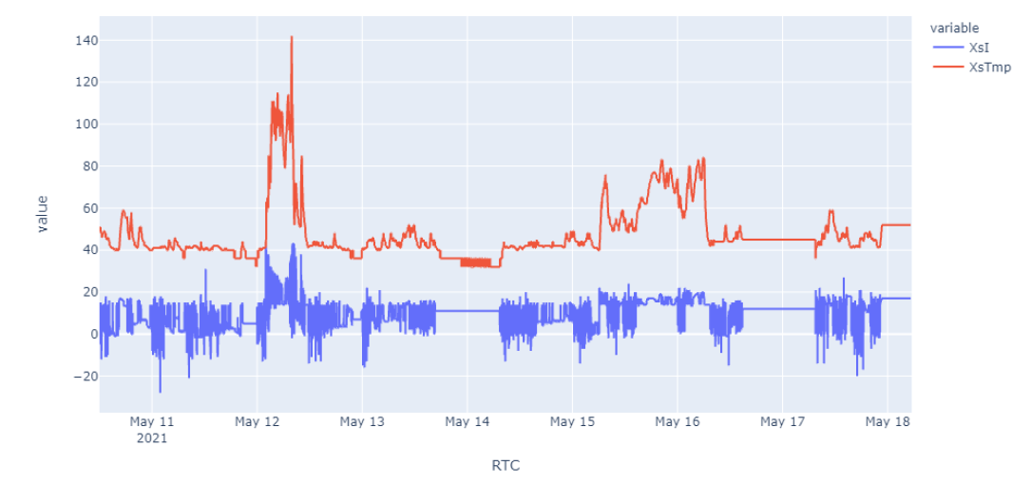
Example 2: Motor Temperature and Current
Sudden Increase in Motor Temperature and Current
Observed 8 hours before failure on 12th May
Similar trend for Motor current during the same period
Machine Status Information
Temperature and current started increasing during running state
Continued to rise till 9:00 AM
Machine went under maintenance at 9:00 AM
Significant Indicators for Breakdown
Current and temperature of the Motor
Indicators for the breakdown on 12th May 2021
Notes:
Example 2: Motor Failure
•Both motor temperature and current spiked 8 hours before the machine required maintenance
•The predictive model was able to flag this as abnormal well in advance

Slide 13
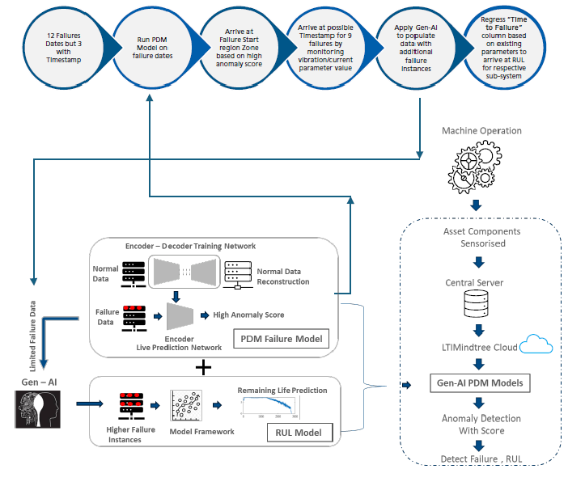
Predicting the Remaining Useful Life (RUL) of the machine
Stage 1: From 12 failure data points out of which only 3 had the exact failure timestamp.
Stage 2: Employ the above trained PdM (Predictive Maintenance Model) model on these data to discover the most probable timestamp when the failure could have happened. The timestamp corresponding to the highest anomaly score could be the most probable failure time. Based on this approach now we have the failure timestamp for 12 points.
Stage 3: Now we use the generative AI technique to generate the synthetic failure data, taking the original 12 data points from above as the base reference to generate the data.
Stage 4: Now after the data generation, we have sufficient data to train our regression model taking the required features to estimate the Remaining Useful Life (RUL).
Notes:
We use a 4-stage RUL estimation process:
1.Start with limited real failure data—only 12 cases, 3 of which had exact failure timestamps
2.Use anomaly scores to estimate failure timestamps for all 12
3.Train generative models (VAEs/GANs) to create synthetic failure scenarios
4.Use the expanded dataset to train a regression model that estimates RUL based on feature trends
This way, we transform scarce real-world data into a rich dataset for more accurate predictions.

Slide 14
Predictive Maintenance Model
Auto Encoder Model Deployment
Trained on strictly non-anomalous data
Objective: flag abnormal behavior deviating from training data
Anomaly Score as Breakdown Indicator
Model's residue used as the anomaly score
Score within threshold: not flagged
Score beyond permissible range: flagged
Early Detection:
The lube oil flow and gearbox temperature disturbances are picked by the model
6 hours before the breakdown (at 03:00 AM).
Required Improvements and Systems
Additional subsystems with IoT data for better failure estimates and RULs
Incorporate a digital twin of the CNC machine using complete IoT system data
Standardize the model with more historical failure instances
Port model to edge server for faster failure detection using On-premises technologies
Notes:
Our Autoencoder Model:
•Trained only on healthy data
•Calculates anomaly scores using reconstruction error
•When the anomaly score exceeds a threshold, it flags potential failure
In one case, it identified oil flow and temperature issues 6 hours before the actual failure, proving its effectiveness for early alerts.

Slide 15
Conclusion
The recent advancement in AI has opened the door to predictive maintenance
Generative AI algorithms are capable of mimicking near-real time instances based on few samples observed and able to generate various operational anomaly instances.
In this application scope, the predictive maintenance solution is being implemented for Upstream equipment Crude Oil Transfer Pumps and to cover critical failure modes.
A Gen AI algorithm will be applied to create anomaly instances and then feeds this data to the predictive maintenance solution to bolster the model health.
In addition, this serves to estimate the Remaining Useful Life (RUL) of the COTP in advance.
Notes:
To make the system more robust:
•We need to integrate additional IoT subsystems for richer data
•Implement a digital twin of the equipment for simulation and control
•Move model inference to edge servers to reduce latency and improve responsiveness
These steps will make predictive maintenance more precise, faster, and scalable.
In conclusion:
•Generative AI enables predictive maintenance even with limited failure data
•It creates realistic anomalies to train better detection models
•The model successfully detected issues hours before breakdown
•It also predicts the Remaining Useful Life (RUL) of machines, helping schedule proactive maintenance
This approach is currently being applied to upstream crude oil transfer pumps, but it is adaptable to any critical equipment with sensor data.
Thank you for your time—I’m happy to answer any questions.

